Slide 1
UMET9G-30-1 Accounting & Finance for Decision Making Capital Structure - Equity

Slide 2

Recap
Last week we covered:
Debt as a source of finance
Key components and types of bond
Calculations
Yield to maturity
Notes:
NOTE TO STUDENTS: Please see last weeks lecture slides and make sure you review them so that you understand how

Slide 3
Learning Outcomes
What is equity
Calculations surrounding share value (using DDM)
Understanding Rights issues and calculations
Types of shares

Slide 4
Recap: Capital Structure – Long-Term Financing
Reminder: Surveys conducted on CFOs’ financing preference show that:
Retained earnings are the CFOs first pick when it comes to financing projects;
Debt is second in-line;
Then comes equity.
Equity capital is the ordinary share capital in the business – finance raised from the ‘ordinary share holders’
Equity financing refers to raising fresh capital by selling shares of the company
Equity represents an ownership position in a corporation, ordinary shareholders have the right to vote on major decisions

Slide 5
Recap: Capital Structure: Equity vs Debt
 | Debt | Equity
Yearly Obligations | Fixed Claim in form of: Interest payments Coupon payments | Residual Claim in form of: Dividend payments (not fixed)
Tax Benefits | Tax Deductible | Not Tax Deductible
Priority | Highest Priority | Lowest Priority
Repayment | Fixed Maturity | Infinite
Management Influence | No Management Control, but may impose restrictions eg disposal | Management Control – votes. Possibility of takeover bids
Arrangement | Relatively easy, low issue costs | Time consuming, higher issue costs for underwriting and distributing shares
Other | Debtholder may impose restrictions. High debt level insolvency risk | Public scrutiny and accountability, enhanced status. Cost of reporting.
Notes:
Debt – impose restrictions – may require debt holders permission to dispose of secured assets, may prohibit further raising of debt finance, may have power to veto new investments they consider too risky

Slide 6
Types of Equity Finance
Retained Earnings
where directors of the company decide to retain and reinvest profits rather than distribute as dividends.
Simplest form of equity finance – avoids issue costs
Issue of new shares to new investors
The directors of the company offer new shares to new investors via:
An offer for sale –IPO, Co. sets an issue price and invites public to buy shares issued that price
An offer for sale by tender – a minimum price for shares is set and investors bid for the shares
A placing – shares are sold or ‘placed’ by a merchant bank directly with an institutional investor or a group e.g. a large pension fund
Rights issue
The existing shareholders are offered the right to buy new shares in proportion to their existing shareholding
Shareholders can take up the rights, sell the rights to another investor OR allow the rights to lapse

Slide 7
Main Types of Share
Preference shares – carry no voting rights, entitle shareholders to a fixed dividend (usually as a % of the value of the share, paid out in priority to ordinary shareholder dividends. May be cumulative or non-cumulative.
Ordinary shares – most common, carry voting rights , entitles share holders to a non-fixed dividend, paid out after preferred shares.
May have different classes of shares within these.

Slide 8
Equity Value
Nominal value | Book value | Market value
The value assigned to a company’s shares when they are issued. It is an arbitrary amount below $1, often $1, $0.50, $0.10, $0.01. Used in SoFP | The book value of shares, the value of a company's equity as reported on the SoFP (TA-TL). To get this per share just divide by the no. of outstanding shares. | Current value on the stock market.
Statutory requirement, cannot issue new shares if market price drops below this. | A measure of the value of the company's assets after all liabilities have been paid, on a per-share basis. | Market capitalisation = Mkt price x no. of shares in issue.
The difference between the market price at issuance and the nominal value is the share premium.
Notes:
The nominal value of equity, refers to the value assigned to a company's shares when they are issued. It is the legal minimum price per share that the company has established.
Key Points:
1. Nominal Value vs. Market Value:
- The nominal value is different from the market value of a share, which fluctuates based on supply and demand in the stock market.
- Nominal value is usually a very small amount (like £1, £0.50, or even £0.01) and has little to do with the actual trading price of the shares.
2. Purpose:
- The primary function of the nominal value is to represent the minimum capital contribution a shareholder makes to the company when they purchase a share.
- It helps protect creditors by ensuring that a company raises at least a certain amount of capital from its shareholders.
3. Impact on Financial Statements:
- On the company's balance sheet, the nominal value of issued shares is recorded in the share capital section under equity. Any amount received over and above the nominal value when shares are issued is recorded in a separate account called the share premium account.
For example, if a company issues 1,000 shares with a nominal value of £1 per share, the nominal value of the equity would be £1,000. If those shares are sold at £5 each, the company would have £1,000 in share capital and £4,000 in share premium.
Key Components of SH Equity:
Common Stock: Represents the par value of all issued shares of common stock.
Preferred Stock: Represents the par value of issued preferred shares, if any.
Retained Earnings: Profits that the company has retained or reinvested in the business instead of distributing to shareholders as dividends.
Share Premium: The amount received by the company above the nominal or par value of the shares when the company issued stock.
Treasury Stock (if applicable): The cost of shares that the company has repurchased from investors, which reduces shareholders’ equity.
Other Comprehensive Income (OCI): Includes unrealized gains and losses from items like foreign currency translation, derivative hedging, and pension liabilities.

Slide 9
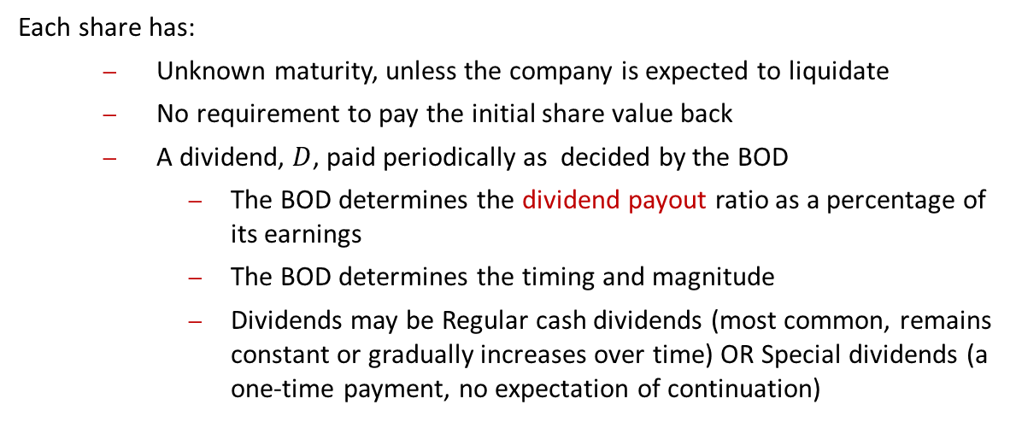
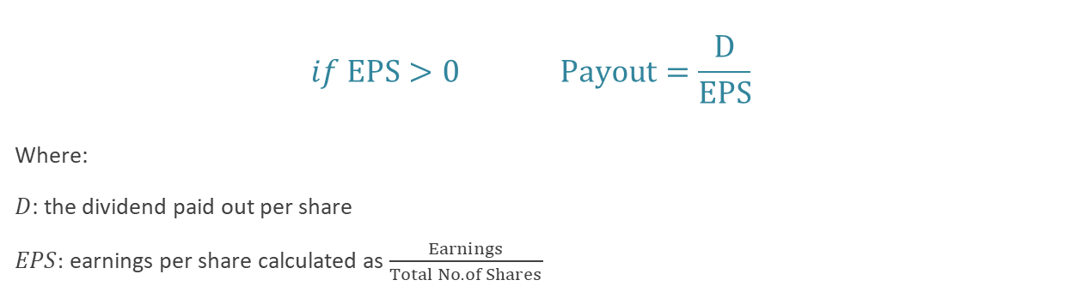
Share Cash Flows
Each share has:
Unknown maturity, unless the company is expected to liquidate
No requirement to pay the initial share value back
A dividend, $D$, paid periodically as decided by the BOD
The BOD determines the dividend payout ratio as a percentage of its earnings
The BOD determines the timing and magnitude
Dividends may be Regular cash dividends (most common, remains constant or gradually increases over time) OR Special dividends (a one-time payment, no expectation of continuation)
$$if EPS>0 Payout=\frac{D}{EPS}$$
Where:
$D$: the dividend paid out per share
$EPS:$ earnings per share calculated as $\frac{Earnings}{Total No. of Shares}$

Slide 10
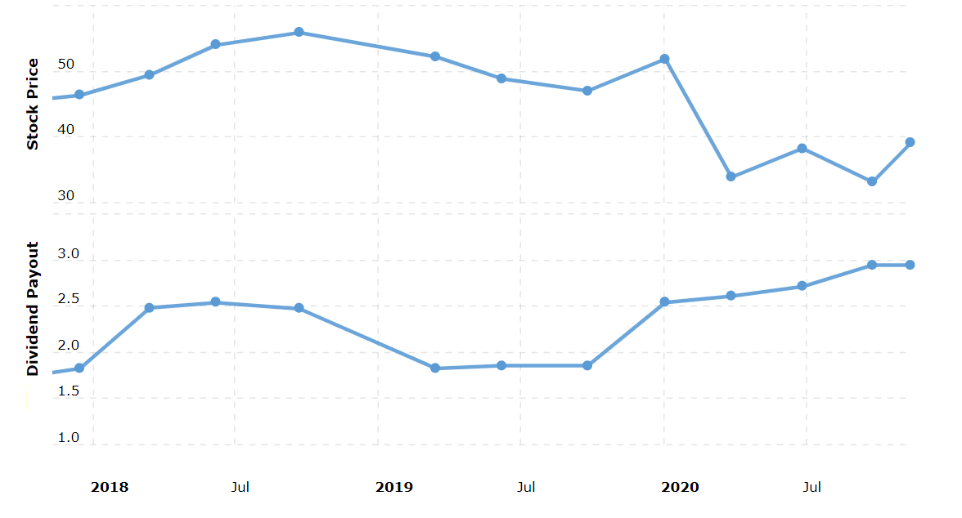
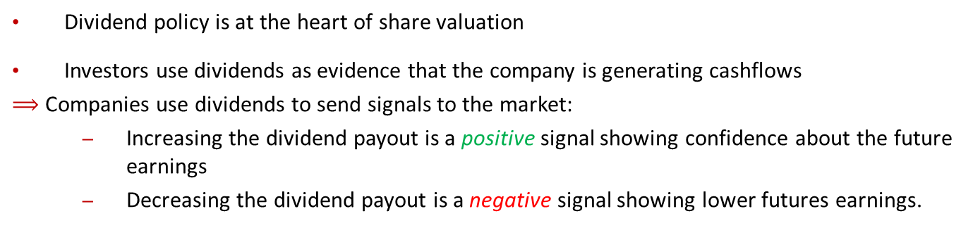
Share Price – Dividends Signalling
Dividend policy is at the heart of share valuation
Investors use dividends as evidence that the company is generating cashflows
$⟹$ Companies use dividends to send signals to the market:
Increasing the dividend payout is a positive signal showing confidence about the future earnings
Decreasing the dividend payout is a negative signal showing lower futures earnings.
Total SA 3-Month Share Price vs Dividend Payout from November 2017 to 2020
Notes:
Procter & Gamble (PG): Procter & Gamble is another company known for its reliable dividend policy. By increasing its dividend for over 60 consecutive years, it signals to investors that it has a strong business model and cash flow, which helps reinforce investor trust and attracts long-term shareholders.
Johnson & Johnson (JNJ): Johnson & Johnson has a solid history of dividend growth. In times of market uncertainty, such as during economic recessions, its commitment to maintaining or increasing dividends can reassure investors about the company's financial health and ability to generate profits.
Apple (AAPL): Although Apple had a long period without dividends, when it resumed paying dividends in 2012 and began to increase them steadily, it signaled that the company was generating enough cash to reward shareholders, even while investing heavily in growth.

Slide 11
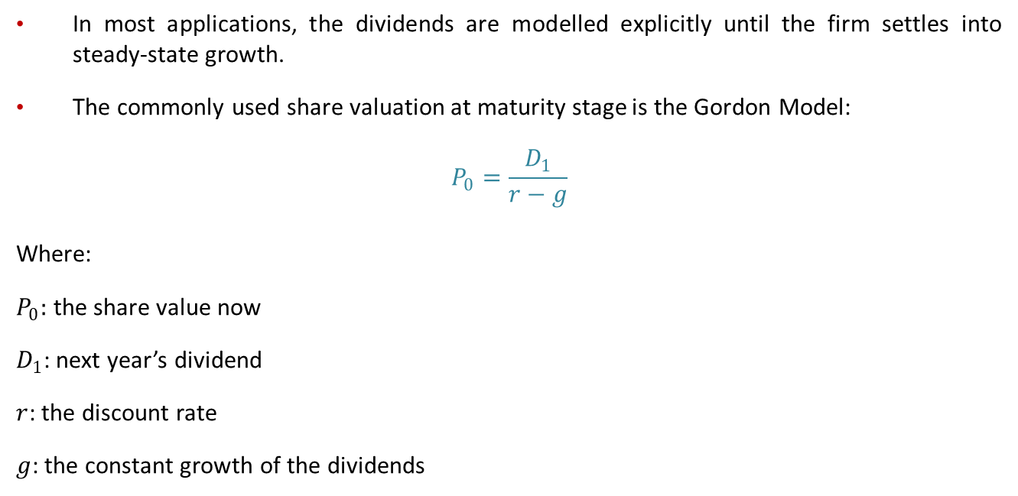
Share Price – Gordon Model
In most applications, the dividends are modelled explicitly until the firm settles into steady-state growth.
The commonly used share valuation at maturity stage is the Gordon Model:
$$P_{0}=\frac{D_{1}}{r−g}$$
Where:
$P_{0}:$ the share value now
$D_{1}$: next year’s dividend
$r$: the discount rate
$g$: the constant growth of the dividends
Notes:
During a company's growth phase, dividends are forecasted individually, but once the company reaches maturity and establishes a consistent growth pattern, the GGM can be effectively used for valuation.

Slide 12
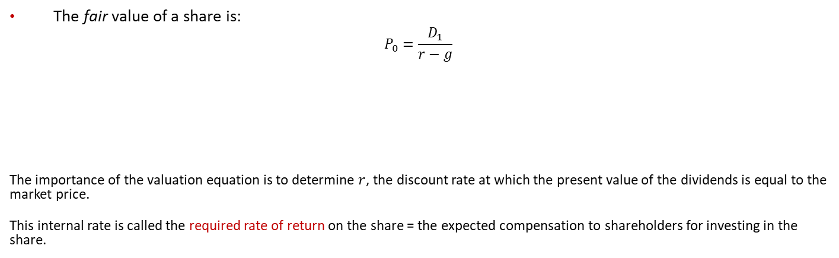


Share Price
Determined by the Board of Directors
The fair value of a share is:
$$P_{0}=\frac{D_{1}}{r−g}$$
The importance of the valuation equation is to determine $r$, the discount rate at which the present value of the dividends is equal to the market price.
This internal rate is called the required rate of return on the share = the expected compensation to shareholders for investing in the share.
$$r$$
Depends on Earnings and the payout ratio
Observed in the market
We can extract the required rate of return on a share as:
$$r= \frac{D_{1}}{P_{0}} + g$$
The capital gain yield (%)
The gain achieved from the growth of dividends as a consequence of the growth of the company’s earnings.
The dividend yield (%)
The gain achieved from the stream of dividend cash flows.

Slide 13










Share Value – Constant $D$
Example: Royal Dutch shares are known to pay a constant dividend of 146.60p per share and are expected to keep paying the same dividend in the future.
Using a discount rate of 8%, what is the fair value of Royal Dutch shares?
Time line
$⇒$ This is a perpetuity. The fair value of a Royal Dutch share is:
$$P_{0}=\frac{146.60}{8\%}=1,832.50p or £18.325$$
$$146.60p$$
$$146.60p$$
$$…$$
$$146.60p$$
$$t=0$$
$$t=1$$
$$t=2$$
$$…$$
$$∞$$

Slide 14
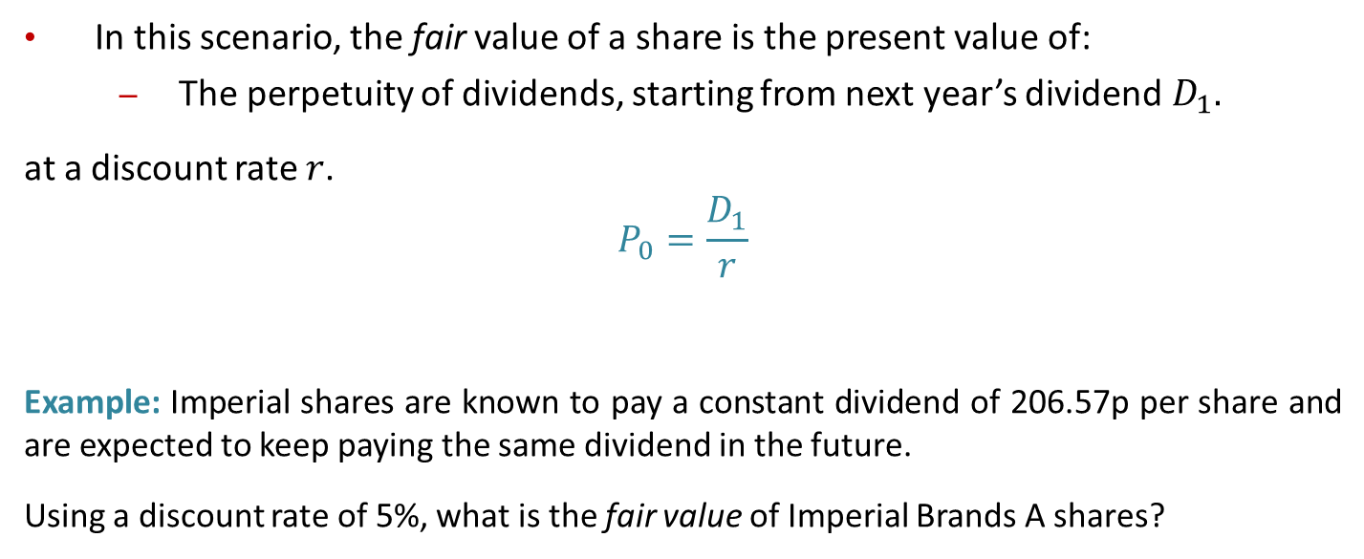
Share Value – Constant $D$
In this scenario, the fair value of a share is the present value of:
The perpetuity of dividends, starting from next year’s dividend$D_{1}.$
at a discount rate $r$.
$$P_{0}=\frac{D_{1}}{r}$$
Example: Imperial shares are known to pay a constant dividend of 206.57p per share and are expected to keep paying the same dividend in the future.
Using a discount rate of 5%, what is the fair value of Imperial Brands A shares?

Slide 15







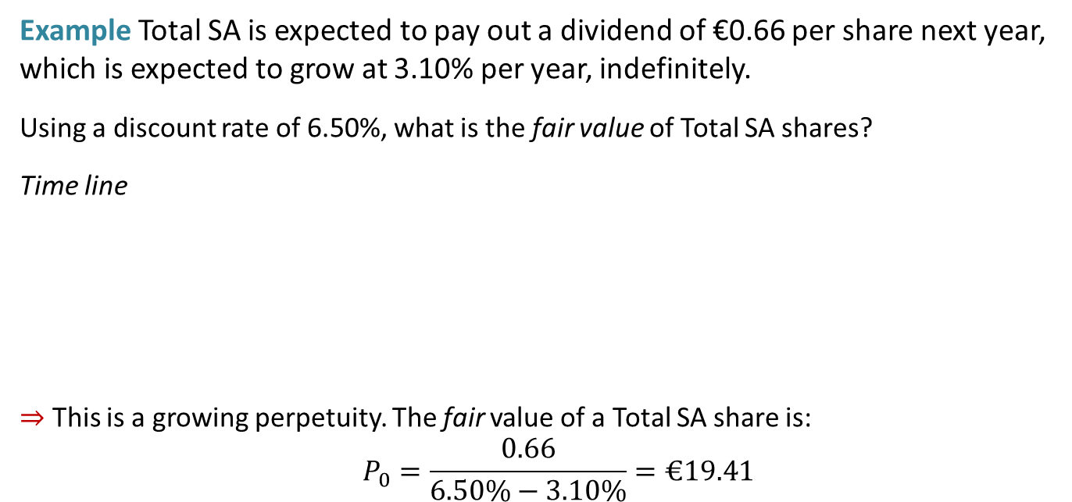


Share Value – Constant Growth $g$
Example Total SA is expected to pay out a dividend of €0.66 per share next year, which is expected to grow at 3.10% per year, indefinitely.
Using a discount rate of 6.50%, what is the fair value of Total SA shares?
Time line
$⇒$ This is a growing perpetuity. The fair value of a Total SA share is:
$$P_{0}=\frac{0.66}{6.50\%−3.10\%}=€19.41$$
$$€0.66$$
$$€0.66×(1+3.10\%)$$
$$€0.66×{\left(1+3.10\%\right)}^{2}$$
$$…$$
$$t=0$$
$$t=1$$
$$t=2$$
$$t=3$$
$$…$$
$$∞$$

Slide 16
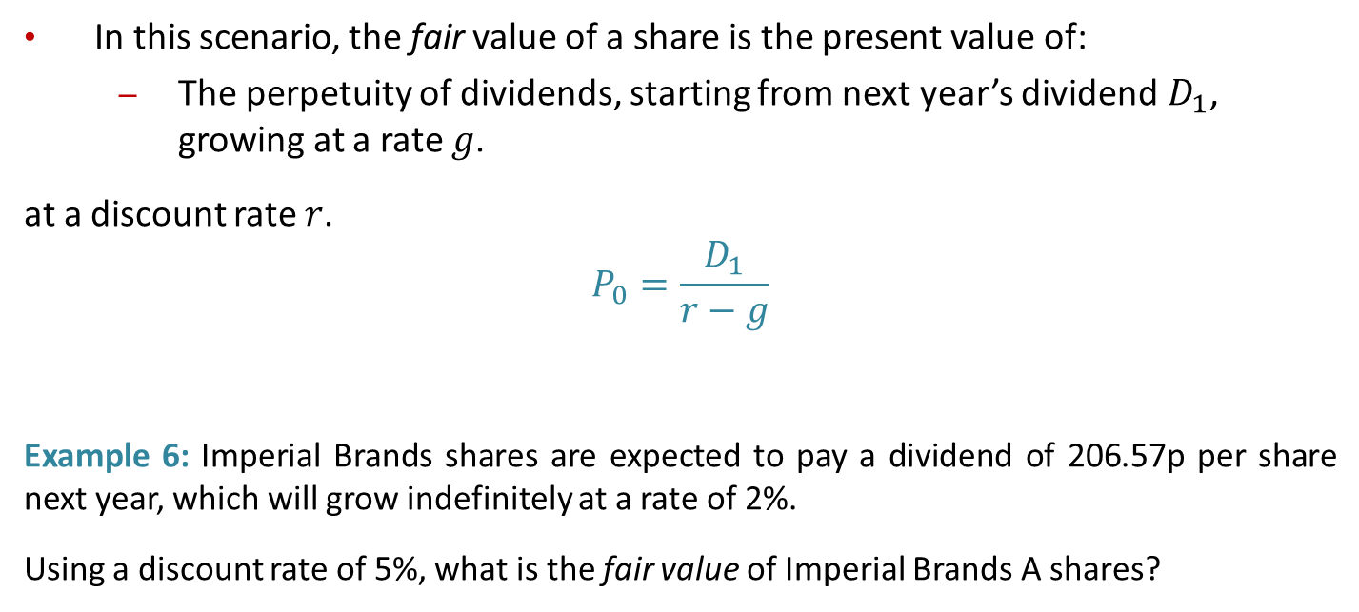
Share Value – Constant Growth $g$
In this scenario, the fair value of a share is the present value of:
The perpetuity of dividends, starting from next year’s dividend$D_{1}$, growing at a rate $g$.
at a discount rate $r$.
$$P_{0}=\frac{D_{1}}{r−g}$$
Example 6: Imperial Brands shares are expected to pay a dividend of 206.57p per share next year, which will grow indefinitely at a rate of 2%.
Using a discount rate of 5%, what is the fair value of Imperial Brands A shares?

Slide 17














Share Value – Non-Constant Growth
Example 7: Reise Plc is expected to pay out a dividend of £0.75, £0.52 and £0.33 per share next three years, respectively, after which the dividend is expected to grow at 2.50% per year, indefinitely.
Using a discount rate of 7%, what is the fair value of Reise Plc shares?
Time line
$$£0.33×\left(1+2.5\%\right)$$
$$=£0.34$$
$$£0.75$$
$$£0.52$$
$$£0.33$$
$$£0.34×\left(1+2.5\%\right)$$
$$…$$
$$t=0$$
$$t=1$$
$$t=2$$
$$t=3$$
$$t=4$$
$$t=5$$
$$…$$
$$∞$$
Non-constant growth
Constant growth @2.5%
We will cover these in the tutorial!

Slide 18

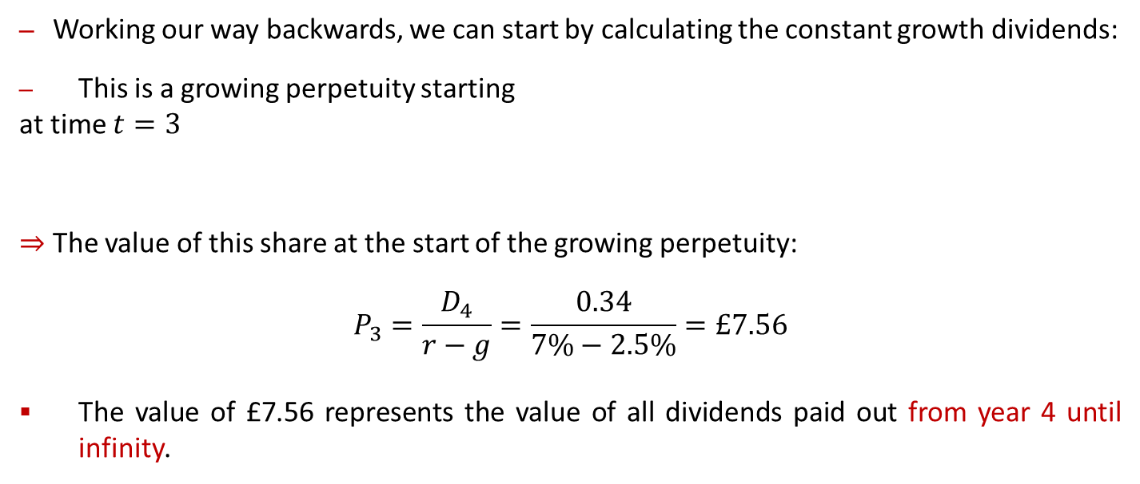







Share Value – Non-Constant Growth
Working our way backwards, we can start by calculating the constant growth dividends:
This is a growing perpetuity starting
at time $t=3$
$⇒$ The value of this share at the start of the growing perpetuity:
$$P_{3}=\frac{D_{4}}{r−g}=\frac{0.34}{7\%−2.5\%}=£7.56$$
The value of £7.56 represents the value of all dividends paid out from year 4 until infinity.
$$£0.34$$
$$£0.34×\left(1+2.5\%\right)$$
$$…$$
$$t=3$$
$$t=4$$
$$t=5$$
$$…$$
$$∞$$

Slide 19

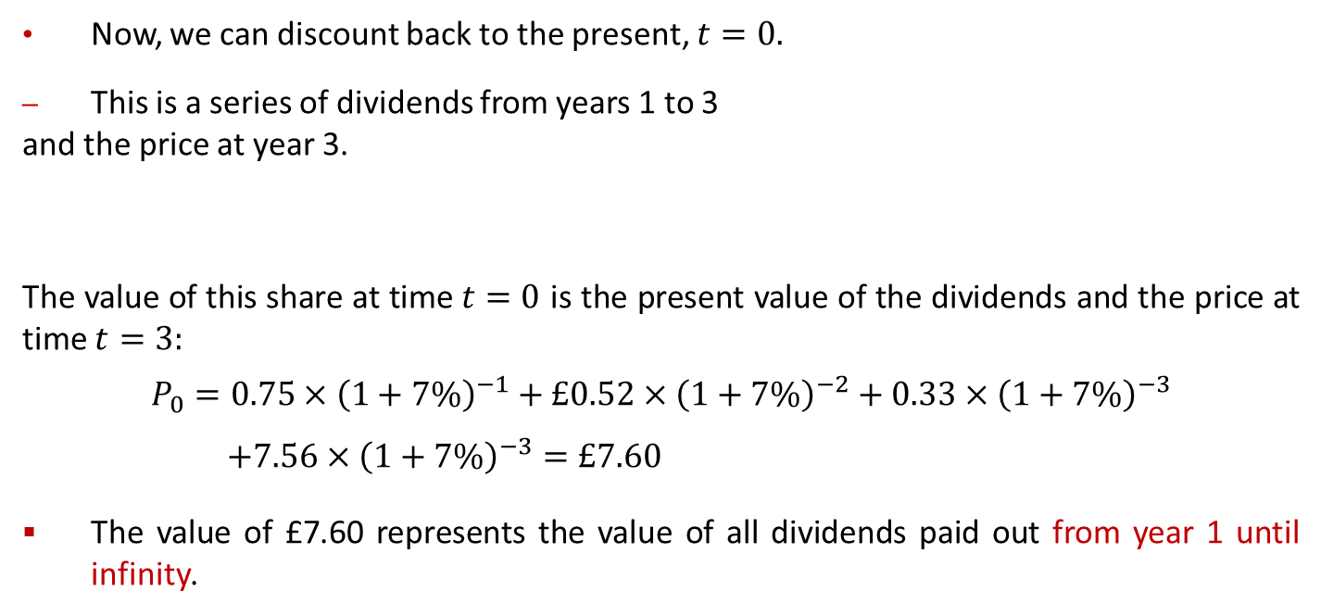







Share Value – Non-Constant Growth
$$£7.56$$
$$+$$
Now, we can discount back to the present, $t=0.$
This is a series of dividends from years 1 to 3
and the price at year 3.
The value of this share at time $t=0$ is the present value of the dividends and the price at time $t=3:$
$$P_{0}=0.75×{\left(1+7\%\right)}^{−1}+£0.52×{\left(1+7\%\right)}^{−2}+0.33×{\left(1+7\%\right)}^{−3}$$
$$+7.56×{\left(1+7\%\right)}^{−3}=£7.60$$
The value of £7.60 represents the value of all dividends paid out from year 1 until infinity.
$$£0.75$$
$$£0.52$$
$$£0.33$$
$$t=0$$
$$t=1$$
$$t=2$$
$$t=3$$

Slide 20
Rights Issue
The company aims to raise additional funds from existing shareholders
Existing shareholders are offered the ‘right’ to buy new shares in proportion to their existing shareholding
Shareholders have three main options:
Take up the rights
Sell the rights to another investor
Allow the rights to lapse
How do we value a rights issue?

Slide 21
Rights Issue - Example
Herbivore PLC is a vegan product distributor. Herbivore has 2 million ordinary shares in issue. Each share is currently trading at £4 on the stock market.
They need to raise £1.12m of new finance to invest in a new renewable product line. It plans to raise the finance by selling new to shares to existing shareholders at a 30% discount to the current market price.
What is the rights issue price?
How many new shares will be issued?
What are the terms of the rights issue?
What is the Theoretical Ex-rights price (TERP)?
Notes:
£4 x 0.7 = £2.80
£1.12m / £2.8 = 400,000 shares
2000000/400000 = 5… 1:5, 1 for 5 rights issue, 1 new share for every 5 existing
TERP = weighted average: EXISTING SHARES 5 x £4 = £20
NEW SHARES 1 x £2.8 = £2.80
TOTAL SHARE 6 x ? = £22.80
TERP ?=22.80/6=£3.80 per share

Slide 22
TERP
The TERP = price at which the shares are EXPECTED TO SETTLE at in a rational market, following the rights issue
Its just the weighted average of the pre rights share price and the price at which the new shares are issued
Its Theoretical and the actuals share price following the issue will depend on shareholders perception of the RI, the investors hope the actual share price rises above the TERP.

Slide 23
Rights issue - Options
Calculate the impact on your wealth if you owned 5% of the shares before the RI, that is 100,000 shares worth £400,000.
Sales of the rights
The value of the rights = TERP – Rights issue price = £3.80-£2.80= £1
So an investor would be prepared to pay up to £1 to the current shareholder and £2.80 to the company, to buy the share.
New value of wealth is 100,000 x £3.80 + 20,000 x £1 =£400,000
Take up the rights
Original wealth = 5% x 2m = 100,000 x £4 = £400,000
After RI = 100,000 + 20,000 = 120,000 shares x £3.80 = £400,000
Allow to lapse
100,000 x £3.80 = £380,000
Notes:
£4 x 0.7 = £2.80
£1.12m / £2.8 = 400,000 shares
2000000/400000 = 5… 1:5, 1 for 5 rights issue, 1 new share for every 5 existing
TERP = weighted average: EXISTING SHARES 5 x £4 = £20
NEW SHARES 1 x £2.8 = £2.80
TOTAL SHARE 6 x ? = £22.80
TERP ?=22.80/6=£3.80 per share

Slide 24
Learning Outcomes Covered
What is equity
Calculations surrounding share value (using DDM)
Understanding Rights issues and calculations
Types of shares

Slide 25
Next Week
WINTER BREAK

